Slide 1
Found Charity Shop – Sales Review
What 2 years of sales are telling us?
Jan 2024 – Dec 2025 | 731 days of till data | £261,261 raised in total
3 methods
Regression, clustering and a forecasting model, each explained in plain English
£131,870
2024 sales
£129,390
2025 sales (down 1.9%)

Slide 2
Every extra visitor is worth about £7.87
Across 610 trading days, footfall was by far the most reliable predictor of takings.
The plausible range is £7.19 to £8.55 per visitor, and the result is statistically very strong.
So anything that gets more people through the door (window displays, events, local posts) pays back predictably.
The model with guests, weekday and month explains about 58% of daily sales.

Slide 3
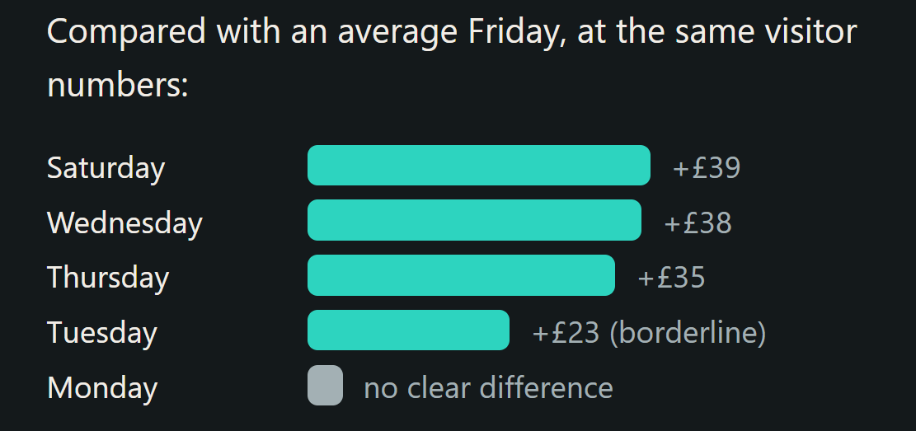
Saturday, Wednesday and Thursday lead

Slide 4
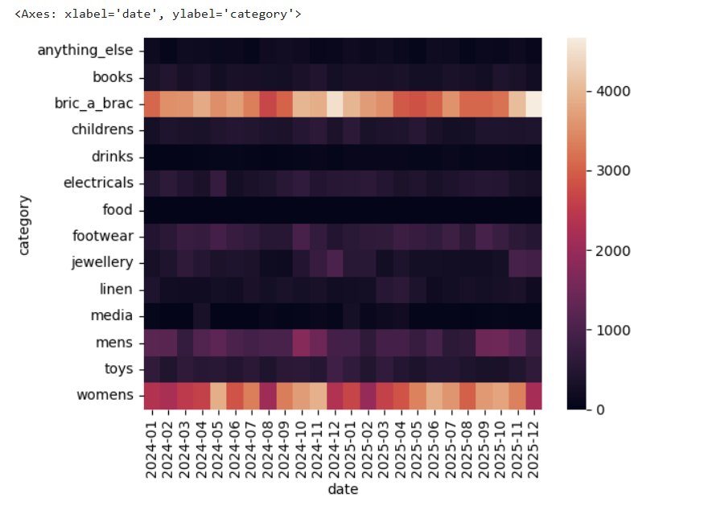
Categories to prioritise when sorting donations
Nearly 60p of every £1 comes from bric-a-brac and women's clothing.

Slide 5
November and December are the peak
+£45 /+ £47
Extra per day in Nov/ Dec versus January, at similar footfall
£13,472
best month: Oct 2024. Quietest: Aug 2024 at £8,521
£9.75
average spend per visitor in Dec 2024, the highest month (low: £7.45 in Aug 2025)

Slide 6
Three things to act on this quarter
Staff the strong days
Put your best volunteers on Wednesday, Thursday and Saturday — the days the numbers show are genuinely busier, not just perceived as busier.
Protect the big two
Bric-a-brac and women's clothing drive ~60% of sales. Prioritise sorting and shelf space for these before anything else.
Start Christmas prep early
Nov–Dec is both busier and higher-spending per visitor. Build seasonal stock and any promotion from September.
Underlying takings are drifting gently down (~£363 to ~£340/day), so it's worth keeping an eye on footfall — since every extra visitor is worth about £7.87, the most reliable lever for reversing that drift is simply getting more people through the door.
- Real focus on window displays and customer service to retain customers

